Slide 1
BITCOIN TRADER
TEAM : CODE TO SURVIVE

Slide 2
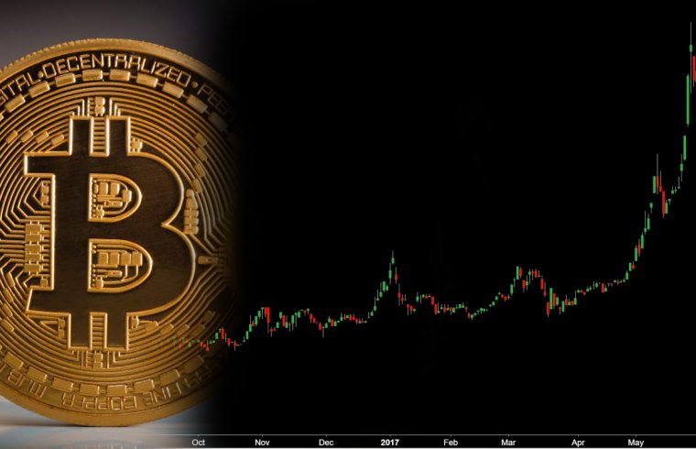
OUR AIM
Maximizing Profit by comparing prices of two bitcoin exchanges and predicting the maximum profit that can be made per minute.

Slide 3
OUR PREDICTIVE MODEL
WE ARE PREDICTING THE CLOSING PRICES OF THE BITCOIN ON THE EXCHANGE COINBASE AND BTC-E AND INVESTING IN THE EXCHANGE BASED ON THEIR MAXIMUM PROFIT PERCENTAGE
OUR MODEL IS TRAINED ON BITCOIN HISTORICAL DATASET FOR THE EXCHANGES ON COINBASE AND BTC-E THAT GIVES US VARIOUS PRICES FOR THE TIMESTAMPS PER MINUTE DIFFERENCE USING THE RECURRENT NETWORKS. THE TRAINING IS DONE ON THE LSTM (LONG SHORT-TERM MEMORY) NETWORK THAT IS TRAINED ON THE DATASET OF ABOUT 3 YEARS

Slide 4
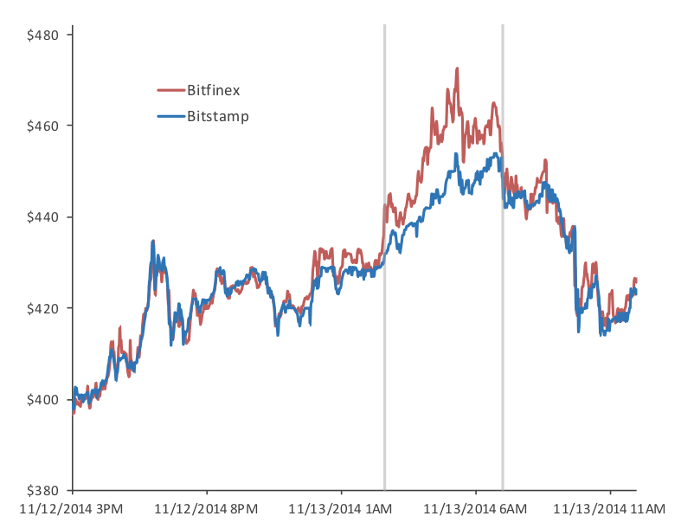
GRAPHICAL REPRESENTATION OF DATA

Slide 5
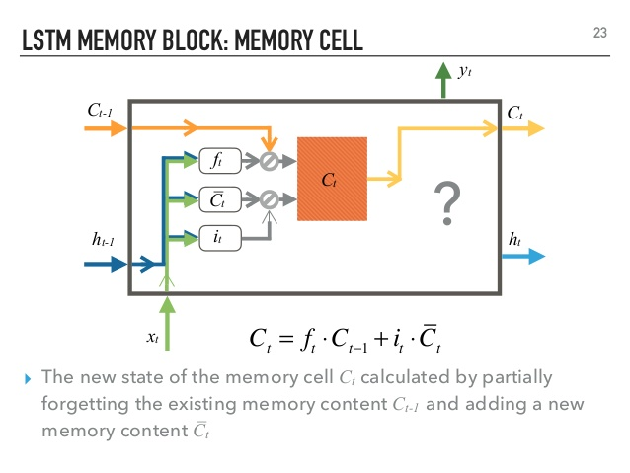
LONG SHORT TERM MEMORY
LSTM block has different gates which have the ability to forget, add new information from/in the current cell state.
ROOT MEAN SQUARE ERROR: 44%

Slide 6
RESOURCES
BITCOIN HISTORICAL DATASET :
https://www.kaggle.com/mczielinski/bitcoin-historical-data/data
LSTM SOURCES :
http://colah.github.io/posts/2015-08-Understanding-LSTMs/
https://medium.com/@shiyan/understanding-lstm-and-its-diagrams-37e2f46f1714

Slide 7
THANK YOU

